Slide 1



Computer System Validation (CSV) AI Agents Hackathon
CNCA Team
Submission Date: 02/05/2025
Team Members:
Hon Lee
Malay Dhang
Stew Wareing
Alec Yates
George Sambrook

Slide 2
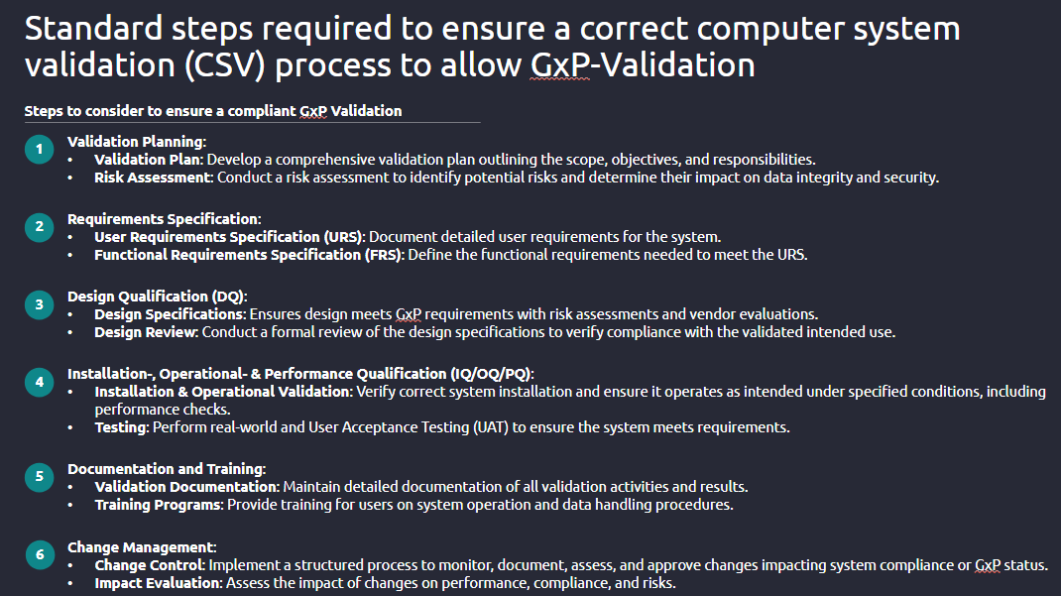

Use Case - CSV

Slide 3
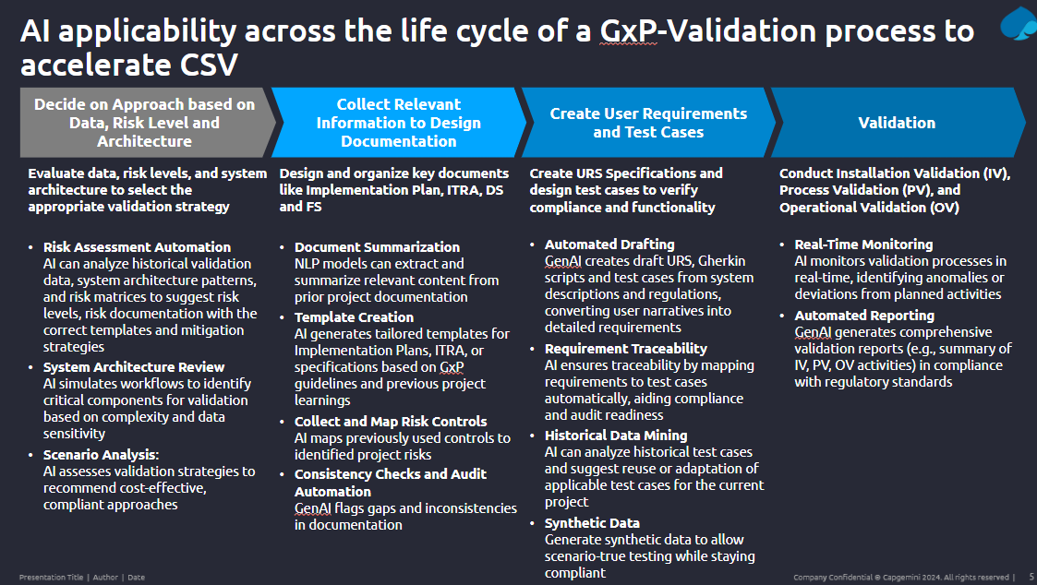
Use Case - CSV

Slide 4














Solution : Multi-Agent System (MAS) - Flow Diagram
1
2
1.1
Validation Planner Agent
Risk Assessment Agent
User Requirement Specification
(URS) Agent
Functional Requirement Specification
(FRS) Agent
Requirement Traceability Agent
1.2
Stakeholder Alignment Agent
3
4
Design Evaluator Agent
Installation Validator Agent (IQ)
Next Page
DQ Document Synthesizer Agent
Test Result Analyzer Agent
Test Execution Agent
Operational Validator Agent (OQ)
Design Reviewer Agent
Performance Validator
Agent (PQ/UAT)

Slide 5







Solution : Multi-Agent System (MAS) - Flow Diagram
5
6
Validation Documentation Agent
6.1
Change Control Agent
Revalidation Planner Agent
Training Agent
Impact Analyzer Agent
Periodic Review Agent
Audit Readiness Agent

Slide 6
About Agents
Validation Planning Phase
AI Agent | Role | Functionality
Validation Planner Agent | Creates a validation plan based on project scope, system category, regulatory context | Uses templates, Natural Language Processing (NLP), prior projects
Risk Assessment Agent | Identifies and prioritizes risks to data integrity, security, and product quality | Good Automated Manufacturing Practice (GAMP 5) rules, risk matrix generation, decision trees
Stakeholder Alignment Agent | Assigns responsibilities, tracks approvals and Responsibility Assignment (RACI models) | Auto-generates responsibility matrices and sends alerts
Requirements Specification Phase
AI Agent | Role | Functionality
User Requirement Specification (URS) Generation Agent | Translates user needs into regulatory-compliant URS | NLP-driven requirement drafting
Functional Requirement Specification (FRS) Builder Agent | Derives detailed functional requirements from URS | Logic mapping, use case modeling
Requirement Traceability Agent | Links URS → FRS → Test Cases | Maintains a live traceability matrix

Slide 7
About Agents
Design Qualification (DQ)
AI Agent | Role | Functionality
Design Evaluator Agent | Assesses vendor and design compliance with GxP (good practice) | Template validation, scoring algorithms
DQ Document Synthesizer Agent | Generates or updates DQ docs and vendor audit reports | Uses previous templates, LLMs
Design Reviewer Agent | Reviews and flags inconsistencies in design docs | LLM with compliance checker logic
Installation Qualification (IQ)/ Operational Qualification (OQ) / Performance Qualification (PQ)
AI Agent | Role | Functionality
Installation Validator Agent (IQ) | Validates that system hardware/software is installed per spec | Reads install logs, config data
Operational Validator Agent (OQ) | Tests operational performance under various conditions | Generates test cases, evaluates logs
Performance Validator Agent (PQ/UAT- user acceptance testing) | Runs user acceptance scenarios & real-world tests | Compares expected vs actual behavior
Test Execution Agent | Automates and tracks test execution | CI/CD or test tool integration
Test Result Analyzer Agent | Assesses and logs pass/fail criteria | Flags issues, supports CAPA logging (document actions taken to correct or prevent non-conformances in products)

Slide 8
About Agents
Documentation & Training
AI Agent | Role | Functionality
Validation Documentation Agent | Auto-generates Validation Master Plan (VMP), protocols, reports, traceability matrices | LLM + document template system
Training Agent | Creates user-specific training modules and quizzes | Based on system roles, usage logs
Audit Readiness Agent | Prepares audit packages and reviews gaps | Ensures 21 CFR Part 11/Annex 11 readiness, timestamps, e-signatures
Change Management
AI Agent | Role | Functionality
Change Control Agent | Creates and manages change records with audit trail | Hooks into change management tools (e.g., ServiceNow, Jira)
Impact Analyzer Agent | Evaluates how a change affects validation state | Dependency graph, ML prediction of high-risk areas
Revalidation Planner Agent | Triggers selective revalidation workflows | Suggests scope, needed test updates
Periodic Review Agent | Monitors system state and flags review timelines | Keeps system within compliance window

Slide 9
Summary Table of All AI Agents
Phase | Agent | Key Function
Validation Planning | Validation Planner, Risk, Stakeholder | Plan, scope, assign
Requirements Spec | URS Generator, FRS Builder, Traceability | Requirements generation and linking
Design Qualification | Design Evaluator, Reviewer, DQ Synthesizer | Compliance and design validation
IQ/OQ/PQ | Install/Operational/Performance Validators, Test Agents | Testing & tracking
Documentation | Documentation Synthesizer, Training Agent | Compliance docs, onboarding
Change Management | Change Control, Impact Analyzer, Revalidation Planner | Lifecycle revalidation
Ongoing Review | Periodic Review Agent, Audit Agent | Compliance health checks

Slide 10
Hackathon – Objectives and Scope of Engagement
Creation of Validation Planning for medical equipment with the help of AI Chat?
The creation of a Validation Plan for medical equipment using OpenAI ‘gpt-4o’ model involves leveraging AI-driven natural language generation and document structuring capabilities to develop a compliant, structured, and traceable document that outlines the strategy for verifying that medical equipment meets its intended use, user needs, and regulatory requirements. Application uses a multi-agent AI framework to intelligently manage and streamline the validation planning process.
Medical equipment Validation Planning compliance check using GMP compliance document with the help of AI Chat?
Application leverages advanced AI capabilities to simplify and automate the validation planning process for medical equipment in accordance with Good Manufacturing Practice (GMP) and regulatory standards. Bing Search plugin id used to access external knowledge beyond the LLM's native training data. It is a hybrid intelligence approach that combines internal reasoning with real-time external research.

Slide 11
Technology & Tools
Semantic Kernel
Multi-agent
Embedding and vectorization
Azure Open AI service + gpt-4o model
Bing Search plugin
ASP.NET
AI Chat Web App scaffolding template
https://github.com/capgemhon/AspireAIAgentsCSVSChat
https://github.com/capgemhon/AspireAIAgentsCSVSChat/blob/master/LLM%20document%20comparison.docx
Code Repository and valuation Results from the Demo
Improvement Area: While the demo successfully met its core objectives, there is potential for improvement in specific areas, which can be further explored in upcoming discussions.

Slide 12
About Capgemini
Capgemini is a global business and technology transformation partner, helping organizations to accelerate their dual transition to a digital and sustainable world, while creating tangible impact for enterprises and society. It is a responsible and diverse group of 340,000 team members in more than 50 countries. With its strong over 55-year heritage, Capgemini is trusted by its clients to unlock the value of technology to address the entire breadth of their business needs. It delivers end-to-end services and solutions leveraging strengths from strategy and design to engineering, all fueled by its market leading capabilities in AI, cloud and data, combined with its deep industry expertise and partner ecosystem. The Group reported 2023 global revenues of €22.5 billion.
Thank You.
Get the future you want | www.capgemini.com

